Slide 1

Fast Gear>>>
The project in C
Online Movie Ticket Booking System In C Programming
Notes:
To change the image on this slide, select the picture and delete it. Then click the Pictures icon in the placeholder to insert your own image.

Slide 2
Project Information
Project Name: Online Movie Ticket Booking System In C Programming
Introduction:
Movie Ticket Booking System is based on the concept to generate the Movie records and to add & update it. Here User can add Movie title with their ticket price and release date details safely and it’s not time consuming. This System makes easy to store records of each and every employee. The whole project is designed in ‘C’ language and different variables and strings have been used for the development of this project. This mini project is easy to operate and understand by the users.

Slide 3
Features:
. Proper Log-In System.
. Password Protected.
. Easy To Add, Modify, Store And Process Movie Records.
. Book Tickets and View Transections.

Slide 4
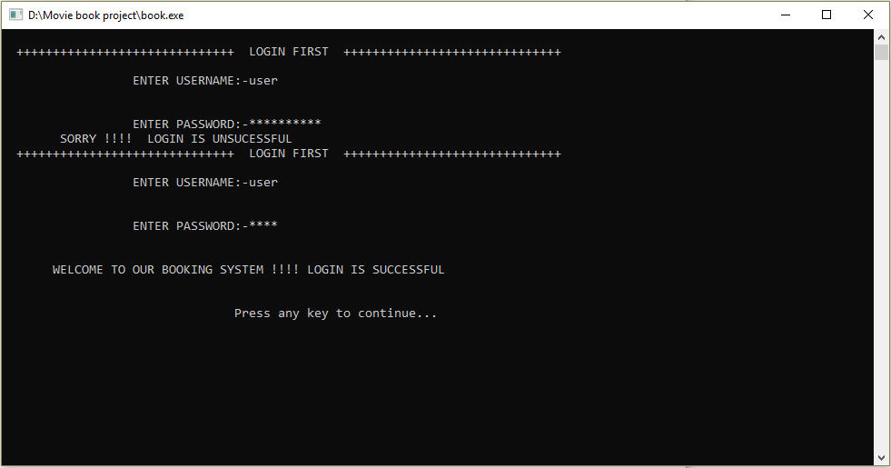
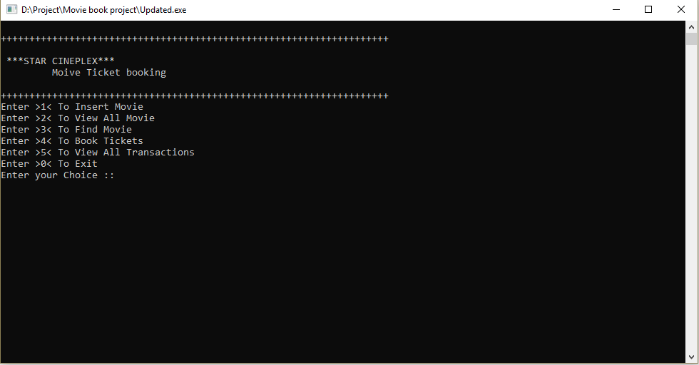
Project Screenshots:
The first picture shows Log-in system. The Log-in system is very secure!
The second picture shows the Main Menu of the project. Where you can select what option you want to choose.

Slide 5
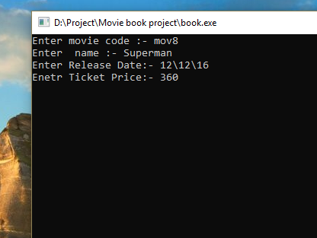
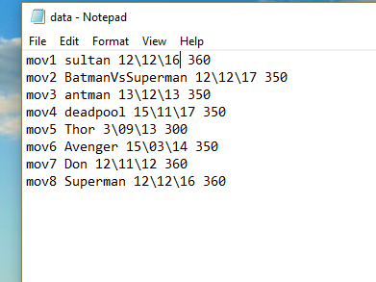
Project screenshots:
After choosing option 1, you have to give a Movie code, Movie name, Movie release date and Ticket price to insert a movie. It will store the information.
The picture shows the stored movie informations.

Slide 6
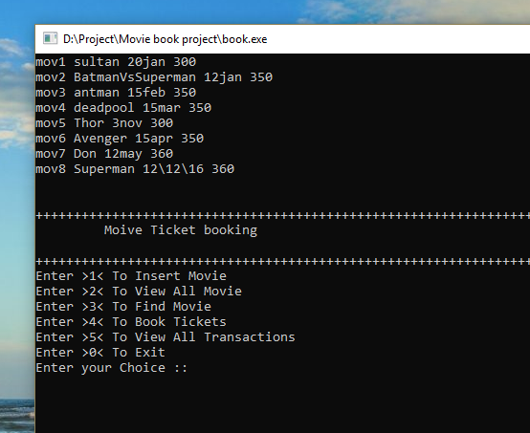
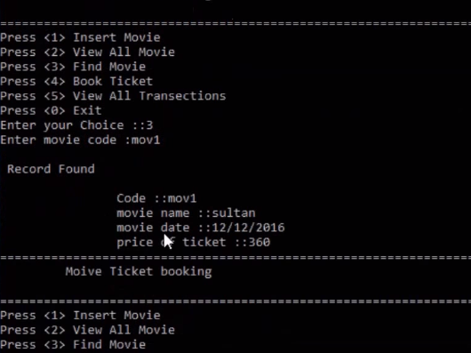
Project Screenshots:
After choosing option 2, the picture shows that the given informations are stored completely.
After choosing option 3, the picture shows the movie you are looking for.

Slide 7
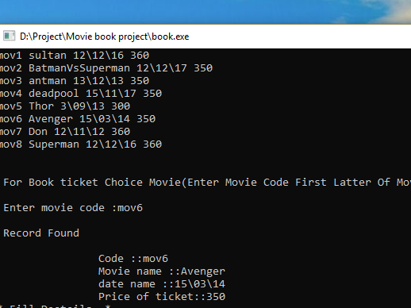
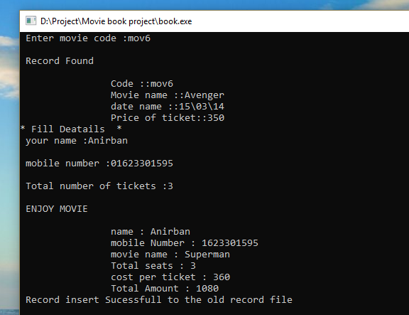
Project Screenshots:
After choosing 4, the picture shows the list of the stored movies and you have to input the movie code, then it will find the record.
Then you have to input Your general informations and it will show the confirmation of the booking.

Slide 8
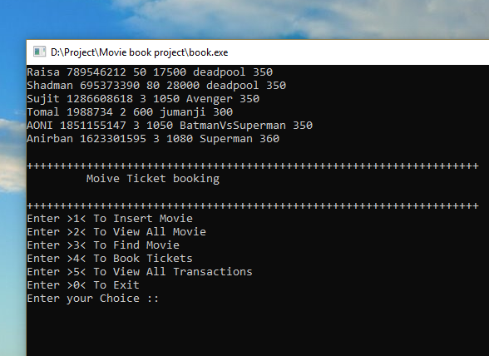
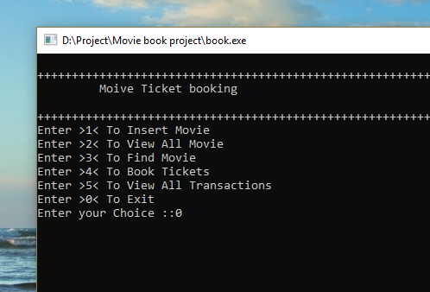
Project Screenshots:
After choosing 5, the picture shows the informations about the recent transactions who had booked tickets.
Press 0 to exit.

Slide 9
Conclusion:
Our project is strongly preferable for a proper booking of movie tickets. The security in our project is a very good point to be noted. The project is password protected, so that customers can feel secure. We included several user friendly programs, features and operations in details in it. Its an online based project. So, customers can easily book tickets for their desired movie from anywhere and anytime. Overall, it doesn’t consume that much time and not very complex for general people. Finally, the system is implemented and tasted according to test cases.

Slide 10
Future Scope:
. We can add a system to create an account.
. We can add printer in future.
. We can give more advanced programs for the system including more facilities.
. We can improve the program for more heavy duties.

